Slide 1


Slide 2
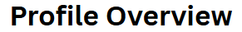

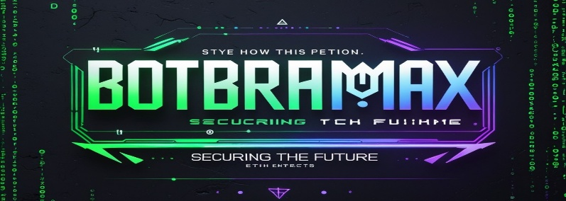
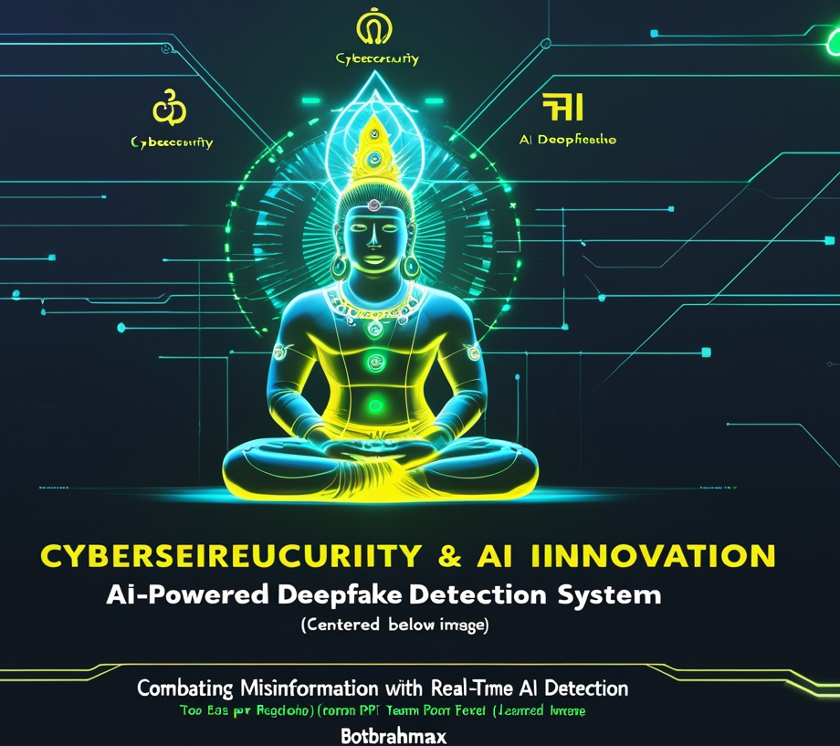

Your Team Name
Theme - (Cybersecurity & AI Innovation)
Problem Statement Title- (AI power Deepfake Detection system)
Team ID - ( )
Team Name - (BotBrahmaX)
Idea submission- Template
www.codecrax.com

Slide 3
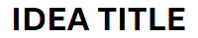
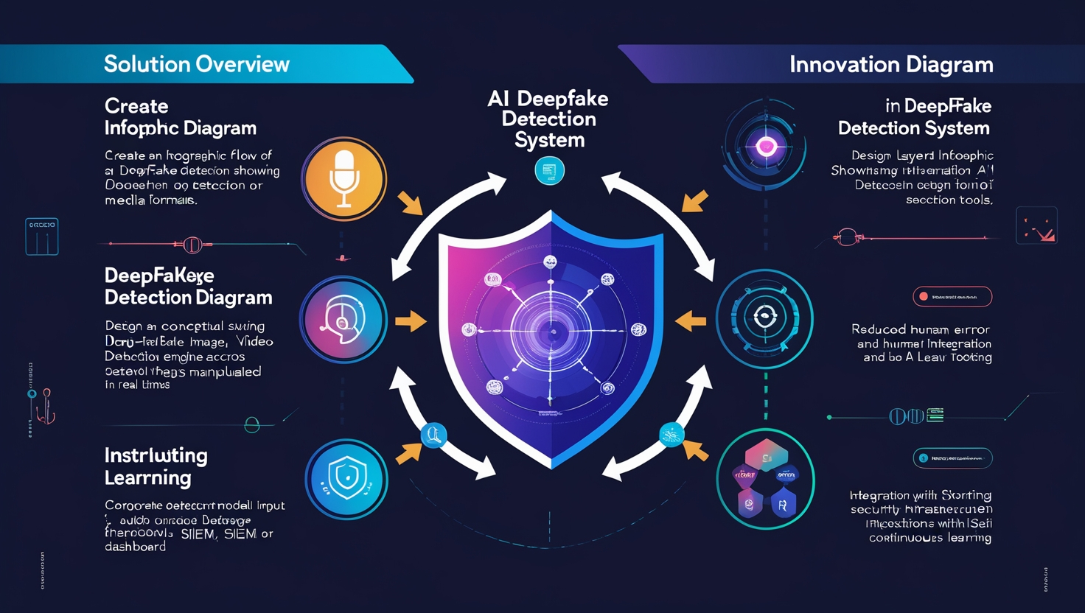
Your Team Name
❑ Solution Overview: - Detects deepfakes in voice, image, and video formats. Flags manipulated media in real-time. Integrates with existing corporate security infrastructure.
❑Problem-Solving: - Addresses cyber fraud, social engineering, and misinformation. Reduces human error and response delays.
❑Innovation: - Real-time detection using multi-modal AI models. Seamless integration with SIEM and endpoint detection tools. Continuous model l
Idea submission- Template
www.codecrax.com

Slide 4
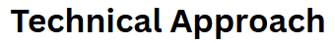
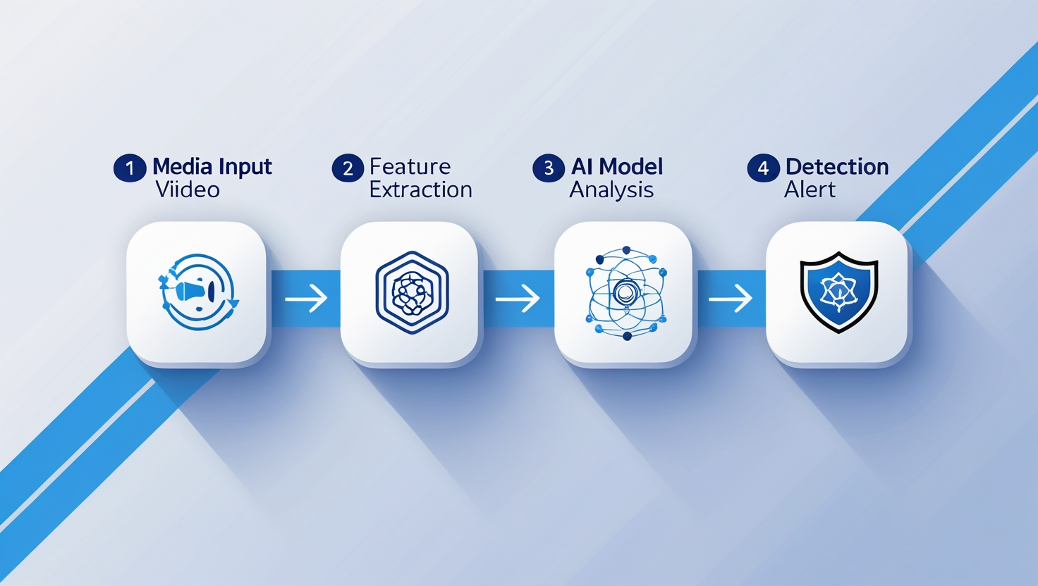
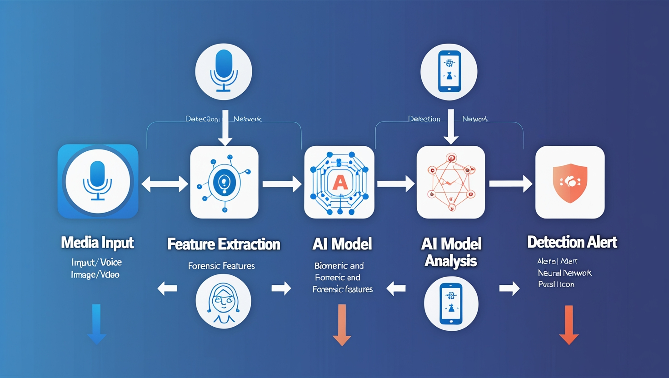
Your Team Name
❖Technologies Used: - Python, TensorFlow, PyTorch, OpenCV. - Pre-trained CNNs, RNNs for audio Analysis. - Real-time APIs, Docker, Kubernetes.
❖Methodology: 1. Input media (voice, video, image) 2. Extract biometric and forensic features. 3. AI models evaluate authenticity. 4. Flag and alert user/system
Idea submission- Template
www.codecrax.com

Slide 5
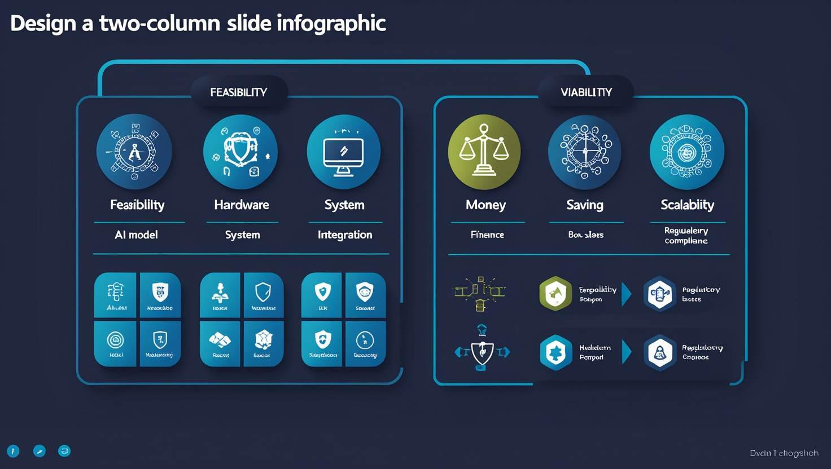
Your Team Name
FEASIBILITY :
✅ Advanced AI Models: Pre-trained CNNs, RNNs, transformers widely available
✅ Real-Time Capability: High-performance hardware enables rapid processing
✅ Easy Integration: Works with existing systems like CCTV, sensors, access logs
💡 Viability :
🏥 Multi-Sector Use: Healthcare, Finance, Government, Security
💰 Cost-Saving: Automation = reduced manual efforts & fraud losses
📈 Scalability: Modular system architecture allows easy expansion
📜 Regulatory Push: Compliance and cyber laws drive adoption
Idea submission- Template
www.codecrax.com

Slide 6
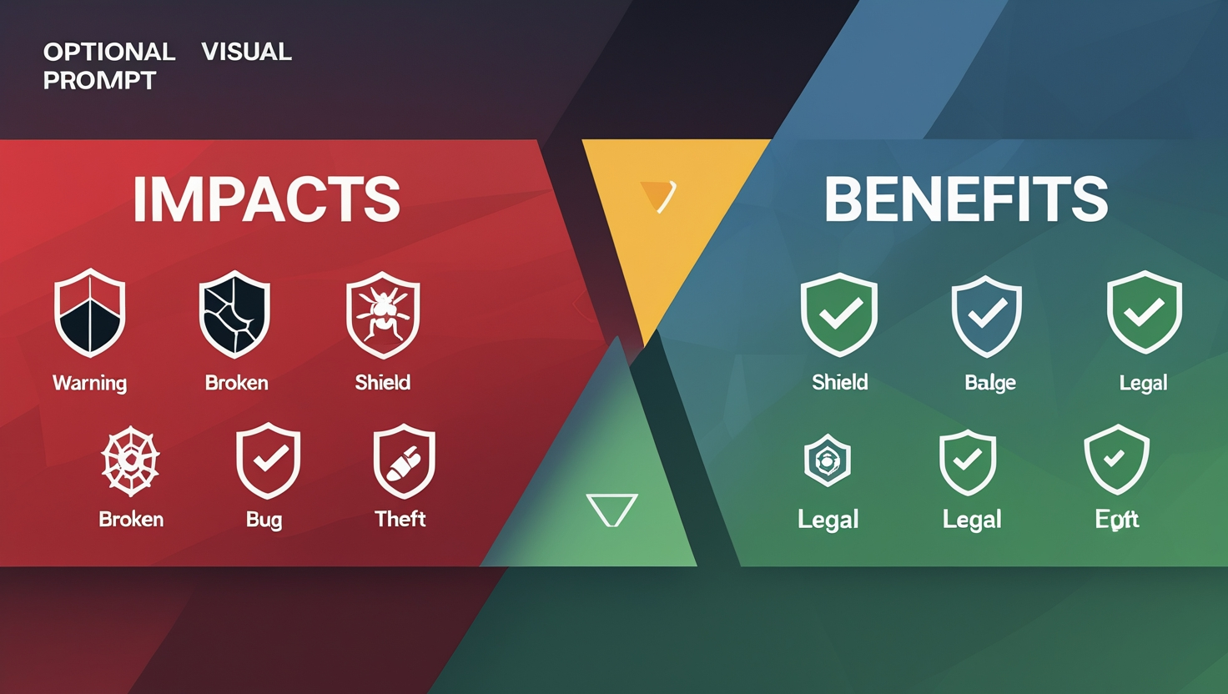
Your Team Name
🔻 Impact (Challenges/Risks from Deepfakes)
False Detection – Incorrectly labeling real content as fake or vice versa
Security Gaps – Existing tools fail to detect sophisticated deepfakes
Data Poisoning – Malicious data used to corrupt training datasets
Model Theft – AI models can be stolen or reverse engineered by attackers
✅ Benefits (Outcomes of Your Solution)
✅ Prevents Fraud & Misinformation – Reduces chances of identity theft, financial scams
✅ Enhances Cybersecurity Posture – Adds an active layer of defense to existing systems
✅ Supports Compliance & Law Enforcement – Helps meet regulatory requirements and aids investigation
Idea submission- Template
www.codecrax.com

Slide 7
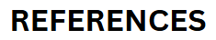
Your Team Name
🧠 Core Framework:
PyTorch – Primary deep learning framework for model training.
🧪 Deep Learning Models:
XceptionNet – Backbone for deepfake detection.
MesoNet (PyTorch) – Alternative architecture for experimentation.
📊 Dataset:
FaceForensics++ – Main dataset for training and evaluation.
📦 Python Libraries:
OpenCV – Image/video processing.
Pillow (PIL) – Image manipulation.
NumPy – Numerical operations.
Torchvision – Image datasets & transforms.
Tqdm – Progress bar for loops and data loading.
🔐 Cybersecurity & Threat Intelligence
MITRE ATT&CK Framework
Learn how attackers use social engineering and deepfakes: 👉 https://attack.mitre.org/
CISA (Cybersecurity & Infrastructure Security Agency)
U.S. government resources on deepfake threats and countermeasures: 👉 https://www.cisa.gov/
🧠 AI, Deep Learning & Model Repositories
Papers With Code (Deepfake Detection)
Explore top models with code for face/video forgery detection: 👉 https://paperswithcode.com/task/deepfake-detection
ArXiv
Research papers on deepfake detection, adversarial learning, etc.: 👉 https://arxiv.org/
📰 News & Trends (AI + Deepfake Legislation)
The Hacker News
Tracks emerging threats and global legal policies on AI misuse: 👉 https://thehackernews.com/
AI Index Report (Stanford)
Annual report that highlights AI trends, risks, and societal impact: 👉 https://aiindex.stanford.edu/
Idea submission- Template
www.codecrax.com

